Slide 1

eCommerce Innovations
Presenter: Gabriel

Slide 2
Agenda
1
3
5
THE PAST OF eCommerce
THE FUTURE OF ECOMMERCE
AMAZON
2
4
6
The success of amazon
STATUS QUO ECOMMERCE
RECO

Slide 3
The past of eCommerce

Slide 4
The past of eCommerce
Basic systems of eCommerce
Electronic Funds Transfer (EFT)
Electronic Data Interchange (EDI)
Advent of World Wide Web Amazon / eBay
Commercial internet use
1970 – 1980s
1980 - 1990s
1990 - 2000s
2000 - 2010s
STATUS QUO
First notable platforms
Boston Computer Exchange
Minitel
eCommerce is everywhere
Online-payments, online advertising, online grocery delivery
Notes:
Recommend 1970-1980s (s… to be changed to small letters)

Slide 5
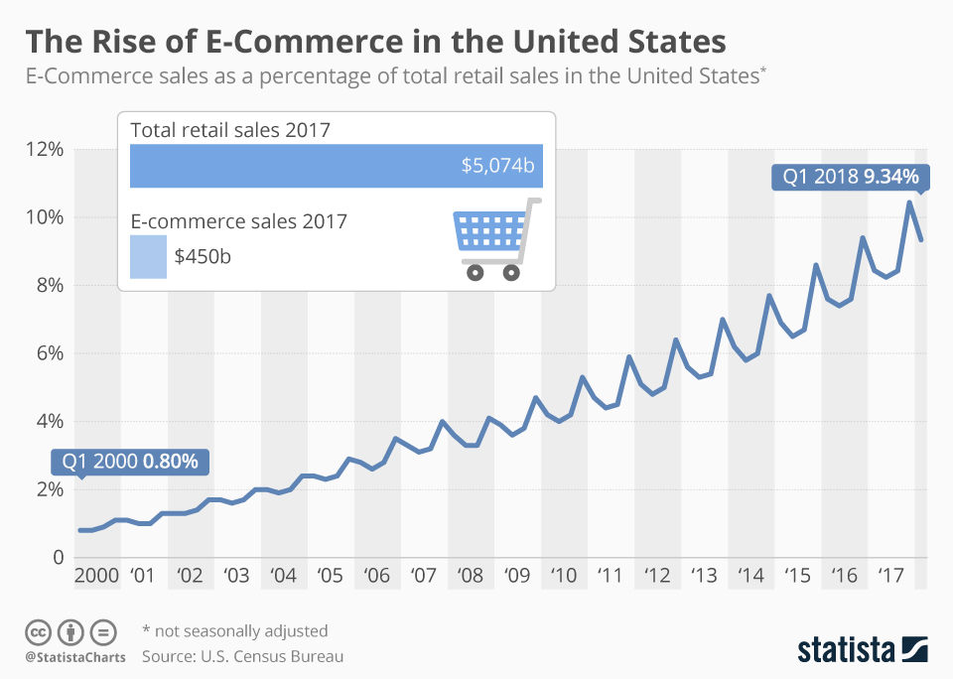

Slide 6



American E-commerce players
Amazon
eBay
Dell
1994
1994
1994
amazon.com is one of the most famous eCommerce organizations and currently leading online platform, with headquarters located in Seattle, Washington. It was founded in 1994 by Jeff Bezos and was one of the first American eCommerce players.
Founded as "AuctionWeb“ Pierre Omidyar started a service that allowed users to bid on each other’s used items.
Focus on the "average guy" instead of tech-companies.
dell.com was the first company to record 1M USD sales online in 1997. High level of customization via internet became a huge success and got imitated by the entire market.

Slide 7
Challenges of eCommerce in the past
1
Trust
3
Awareness
2
4
Security
Accessibility

Slide 8
Status Quo of eCommerce

Slide 9
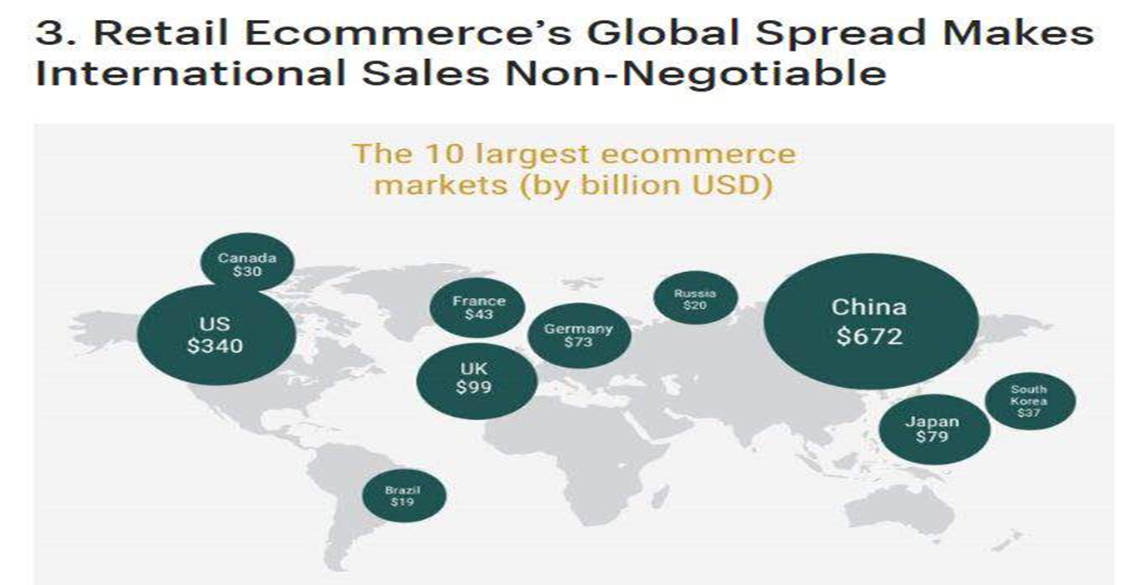




Slide 10

A portable device experience mCommerce
Mobility
Reachability
Ease of transaction
Security - biometrics, face recognition, fingerprints
Location tracking

Slide 11
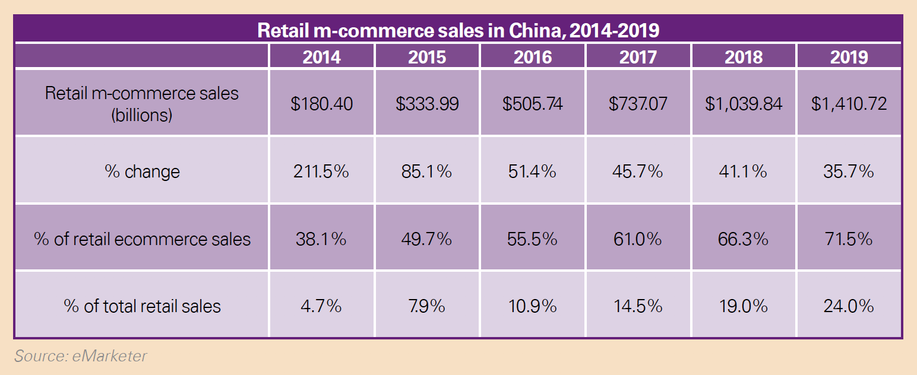

Slide 12
The future of eCommerce

Slide 13
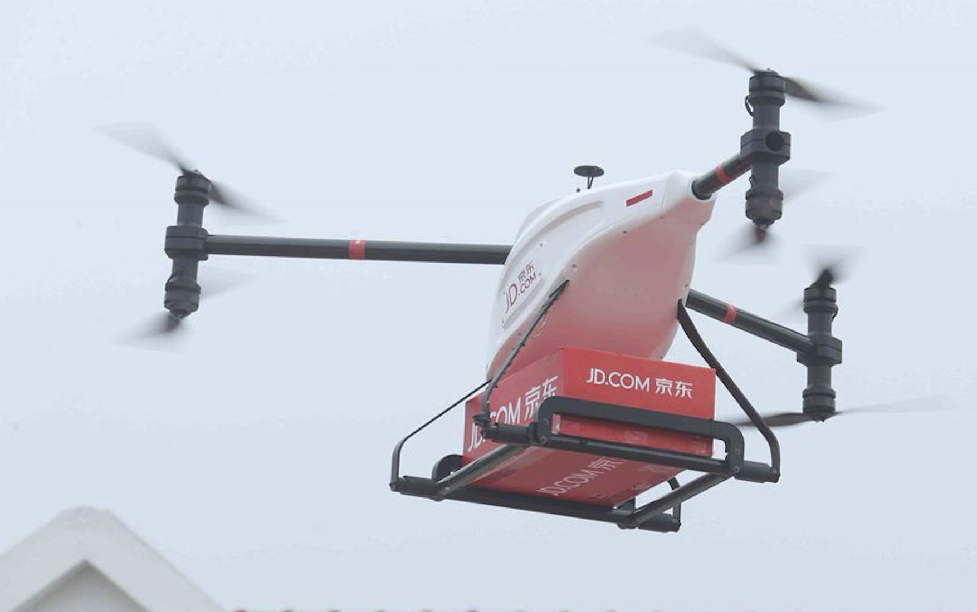
eCommerce & Delivery drones
Higher degree of efficiency
Significantly lower cost
Less logistical hassle and traffic
Less pollution
JD launched a test-run in Shanghai in 2018

Slide 14

Solution support service
Robots are awesome customer service reps
Chatbots
Visual search is changing the way we browse
Sales Improvement
Visual search & image recognition
eCommerce & AI & Blockchain
Handling Customer Data
CRM
have to spend hours searching the product
automate the feedback form
After Sales Service
Recommendation Systems
AI systems build a correlation between the current demand and the future demand.
Better Decision Making
Inventory management
Cybersecurity
Catalogue management
lead to the exposure of private data and online fraud

Slide 15
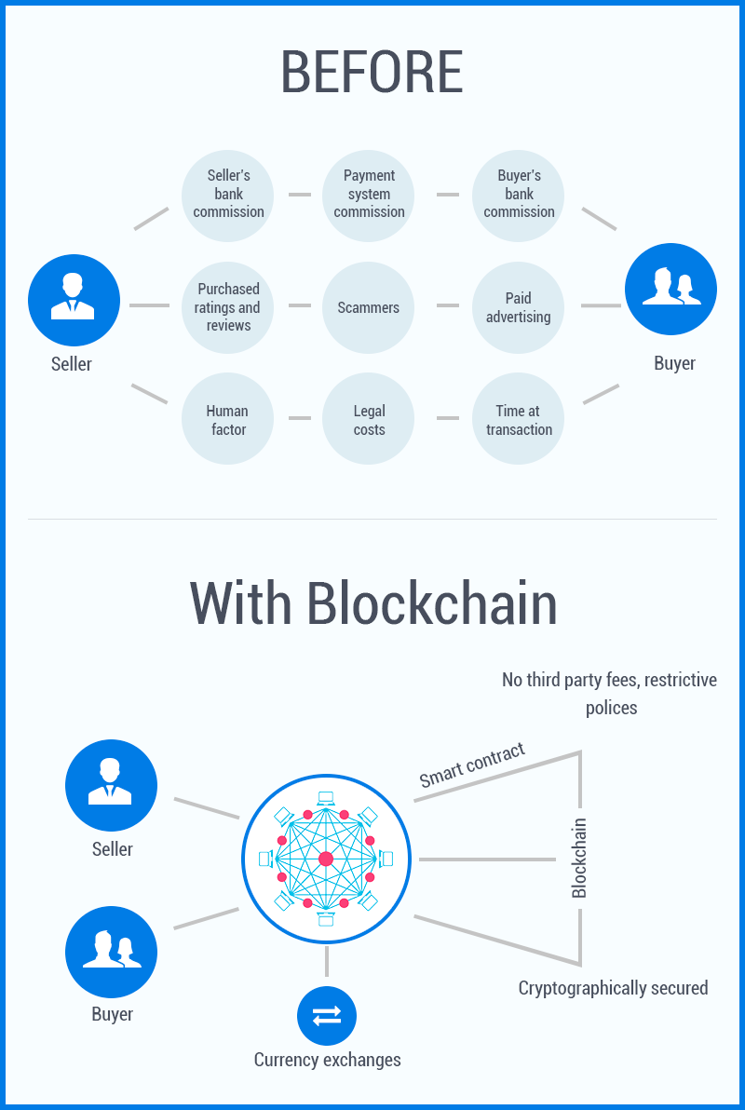
Secured payment
Reduction of transaction costs
Authentic Transactions
Accuracy
Health Hazards
Payments
Proof of Ownership
Human Resources
Advertising and Marketing
Managing Operations
Safer Web World
Cybersecurity
Transparency

Slide 16

Opportunities in emerging markets
Developing markets in Africa & South America
Rapid increase of network coverage and general internet speed
No big eCommerce-player in Africa yet

Slide 17
The success of Amazon

Slide 18
Source: www.macrotrends.net/stocks/charts/AMZN/amazon/market-cap

Slide 19

The success drivers of Amazon
Elimination of distributors
Close cooperation with actual competitors
"Everything you want“ on a single platform
Various delivery-options
Customer-oriented service
Prime Membership
Fast track facility sorting centers
AWS – cloud services generating 7% of revenue

Slide 20
Projected future of Amazon

Slide 21
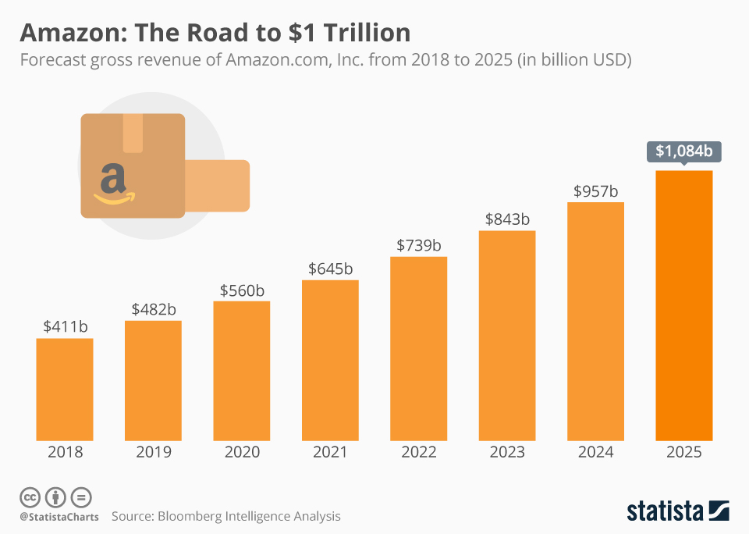

Slide 22
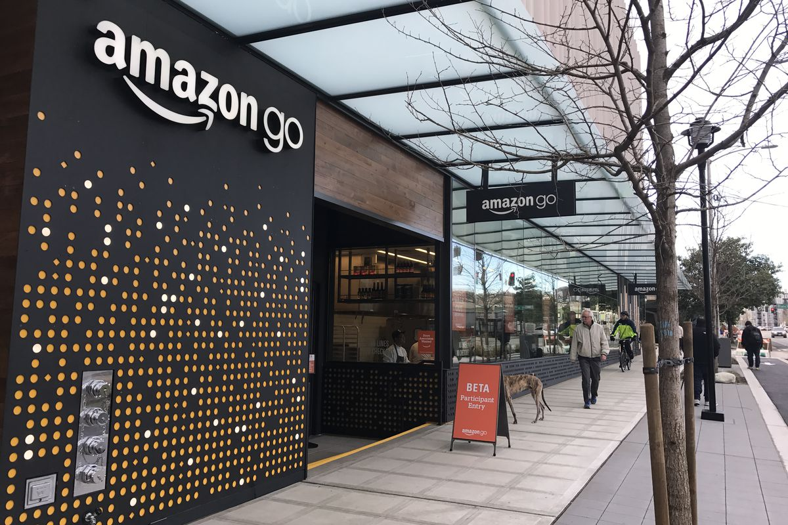
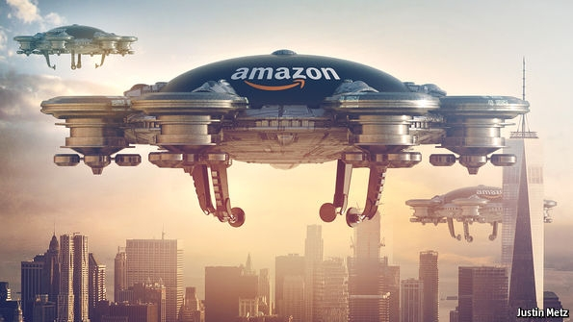
The future tools of amazon
Photo- or video-recognition
More language options
AI assistance
Food delivery
Strong focus on AmazonFRESH
Amazon Healthcare
O2O-connection

Slide 23

How to face new competition
JD & Alibaba
Emerging middle- and upper classes do not associate Chinese products with a high level of quality
Paying attention to developing markets (e.g. Africa) where Chinese companies keep investing

Slide 24
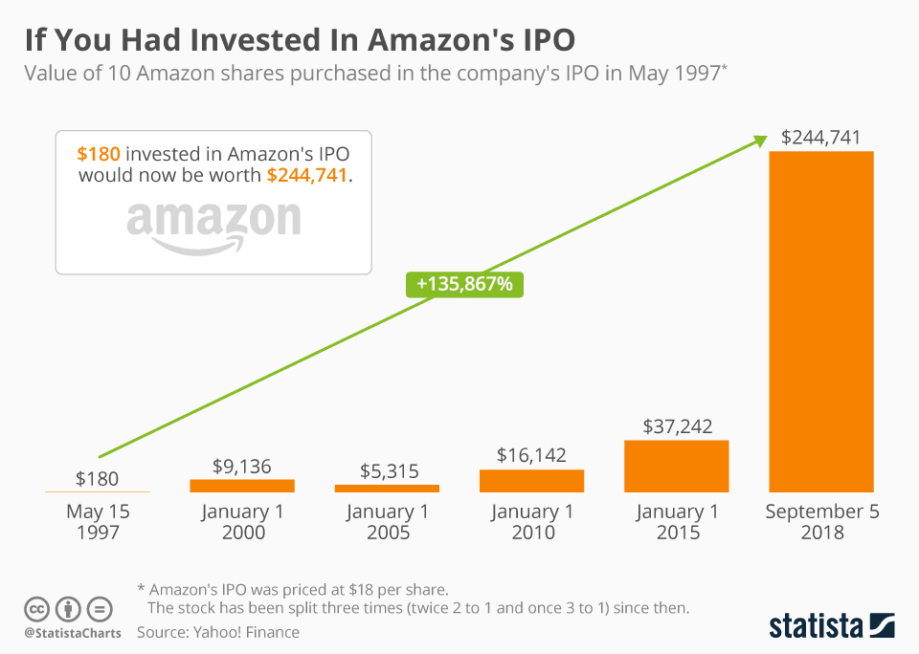
Thanks for listening!

Slide 25
Questions?

